Slide 1

“Space Data Processing: Making Sense of Experimental Data”
Laboratory work 2
Converting a physical distance to a grid distance using least-square method
Tatiana Podladchikova Rupert Gerzer
Term 4, March 28 – May 27, 2016
t.podladchikova@skoltech.ru

Slide 2
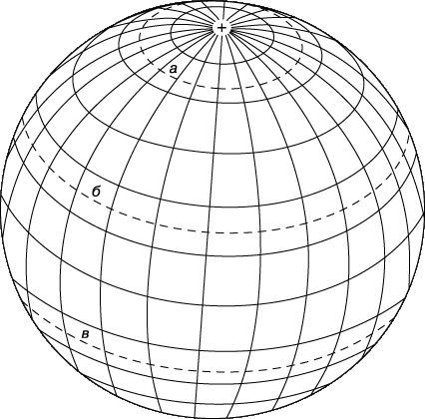
Why we need parallels and meridians of Earth?

Slide 3
Why we need parallels and meridians of Earth?
Grid to indicate any places on Earth’s surface
Needed to study multi-dimensional processes

Slide 4
Orbits of Van Allen Probe A satellite
2016-03-30
Measurements of electron fluxes are obtained at different distances from Earth. The distances varies depending on orbit.

Slide 5















Converting a physical distance to a grid distance using least-square method
Usually measurements are linearly interpolated on a grid with fixed distance between nodes
We will develop a grid scale with minimizing distance between measurements and grid nodes
$$l_{1}$$
$$l_{2}$$
$$l_{3}$$
$$l_{4}$$
$$l_{5}$$
$l_{i}$ - grid nodes
$$Δ$$
$$ξ_{1}$$
$$ξ_{2}$$
$$ξ_{3}$$
$$ξ_{4}$$
$$l_{i}=l_{1}+Δ$$
$l_{i}$ - grid nodes
$ξ_{i}$ - distances of measurements
$Δ$ – distance between nodes

Slide 6
Goals
1
To learn how to formalize a problem
2
Solution without using classical regression models and thus avoiding bulky computations and creation of regression matrix of high dimension
3
Error estimation

